Slide 1
FP7 Collaborative Project
DEMOWARE
Innovation Demonstration for a Competitive and Innovative European Water Reuse Sector
Workpackage 1
Subtask 1.4.2
Adapting water quality to agricultural reuse type
Partners: IRSA-CNR, Fiordelisi s.r.l.
Demo site: Capitanata (Italy)
Kickoff meeting, Manresa (Spain), 12-13 March 2014

Slide 2
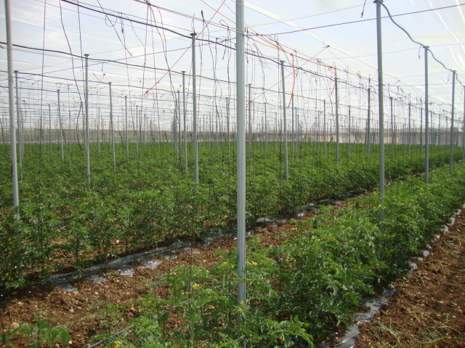
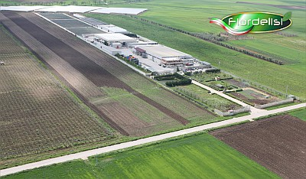
The demo site «Capitanata»
Main focus: Reuse of agro-industry effluents for irrigation of vegetable crops.
The factory produces wastewater during food processing, treats it in-house (activated sludge) and can further treat the secondary effluent (membrane ultrafiltration) to achieve sufficient quality for reuse in its own fields (closed loop).
Depending on irrigation requirements, effluents can be stored into reservoirs or directly sent to the field. UV disinfection of stored effluents is also available.
A conventional source (groundwater) is used for comparison, also taking into account that the local water table is affected by salinization.
Objective: Evaluate agro-industrial wastewater reuse for irrigation as a tool for water savings and resource optimization.

Slide 3
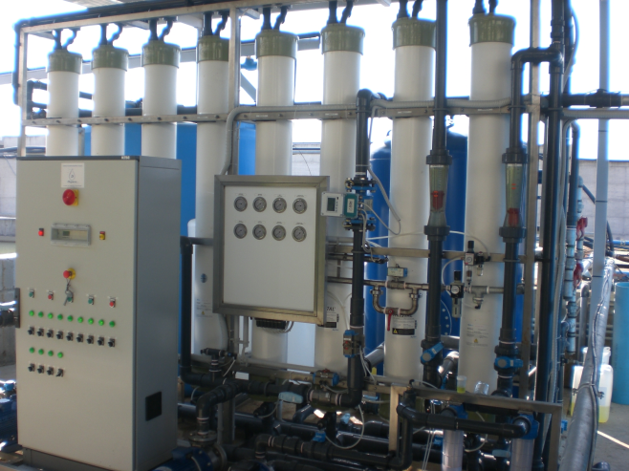
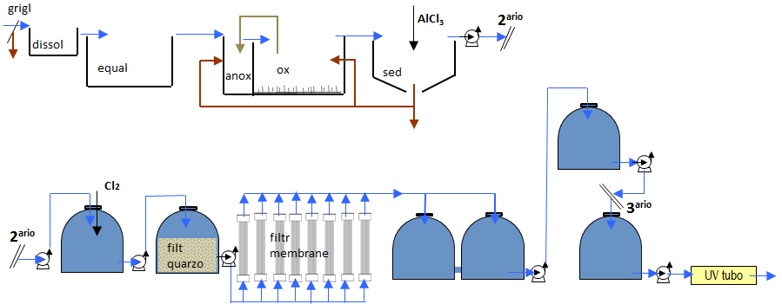
Technologies at the demo site «Capitanata»
Scheme of
the WWPT
Available structures
Industrial wastewater treatment plant (300 mc/d);
Tertiary treatment plant (membrane ultrafiltration);
Pumping station;
Reclaimed water distribution network;
Test fields.
Types of irrigation water: secondary effluent, tertiary effluent after membrane filtration and UV disinfection, well water (control).

Slide 4
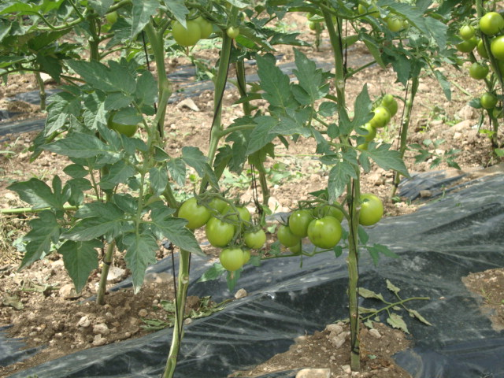
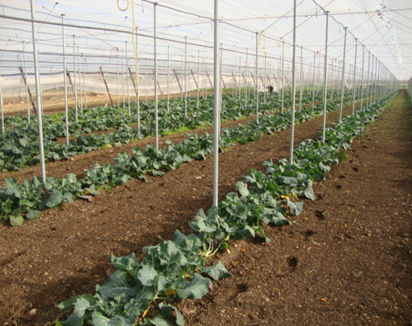
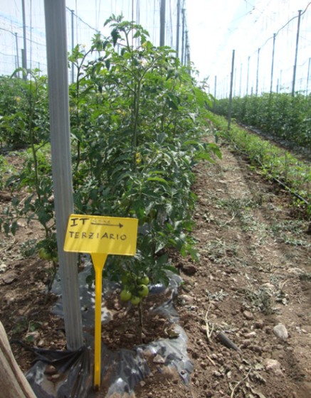
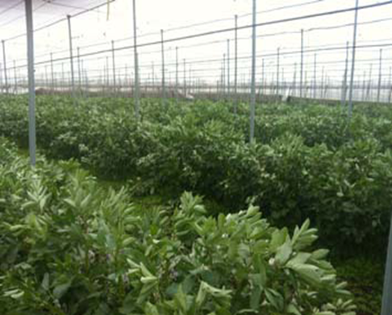
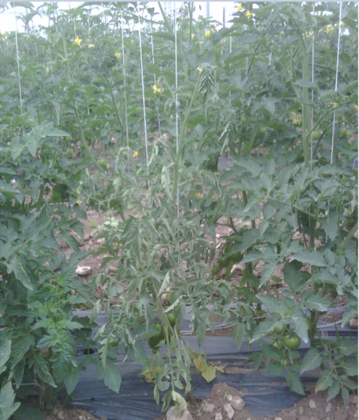
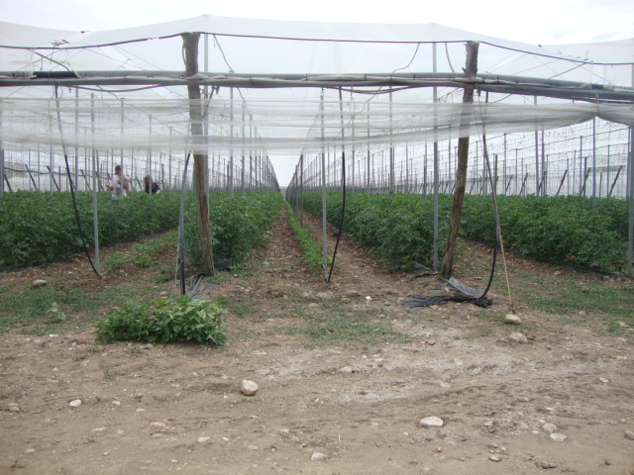
Field scale testing at the demo site «Capitanata»
Parallel plots irrigated with reclaimed water of different quality
Effects of different water quality on different crops.
Barriers to be addressed relate to source water quality and quantity variability, and fitting the treatment scheme to crop quality requirements.

